Slide 1
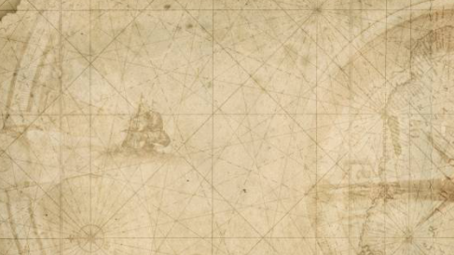
A Primer to Creating Interactive Leaflet Maps in Shiny R Shiny Seminar Series Ecological Forecasting Initiative Ecological Society of America Statistical Ecology Section
Thomas Connor, 9/14/2021

Slide 2
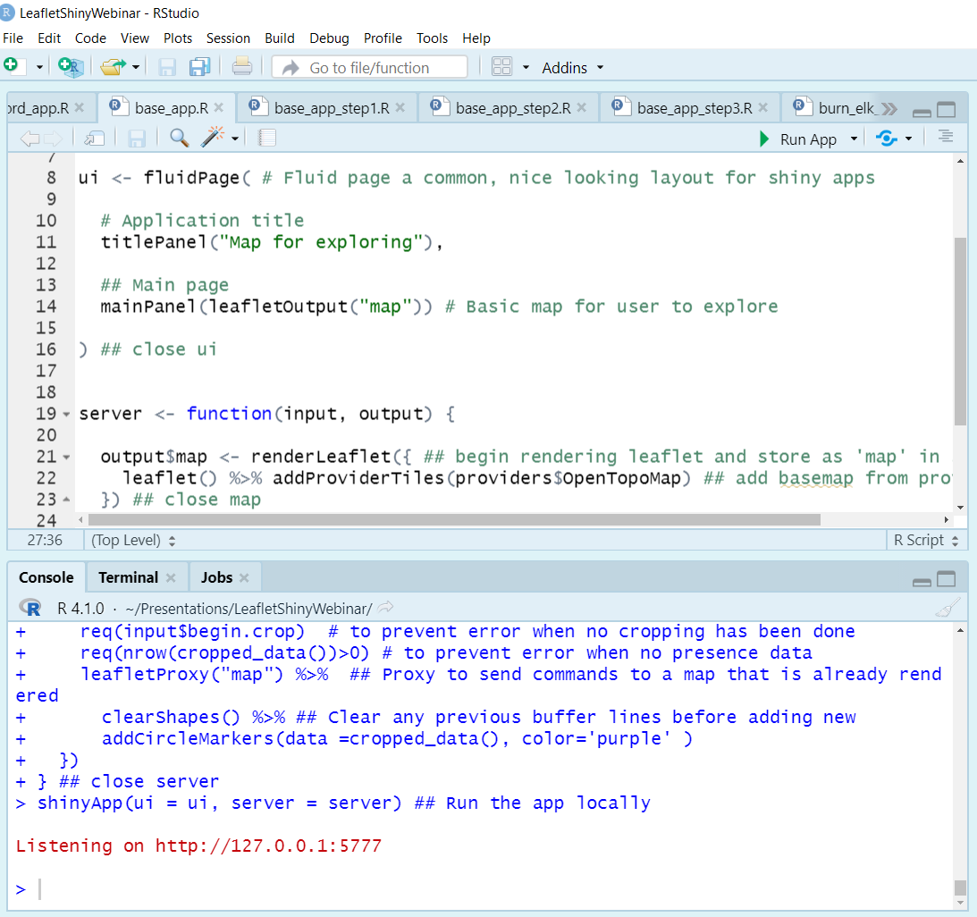
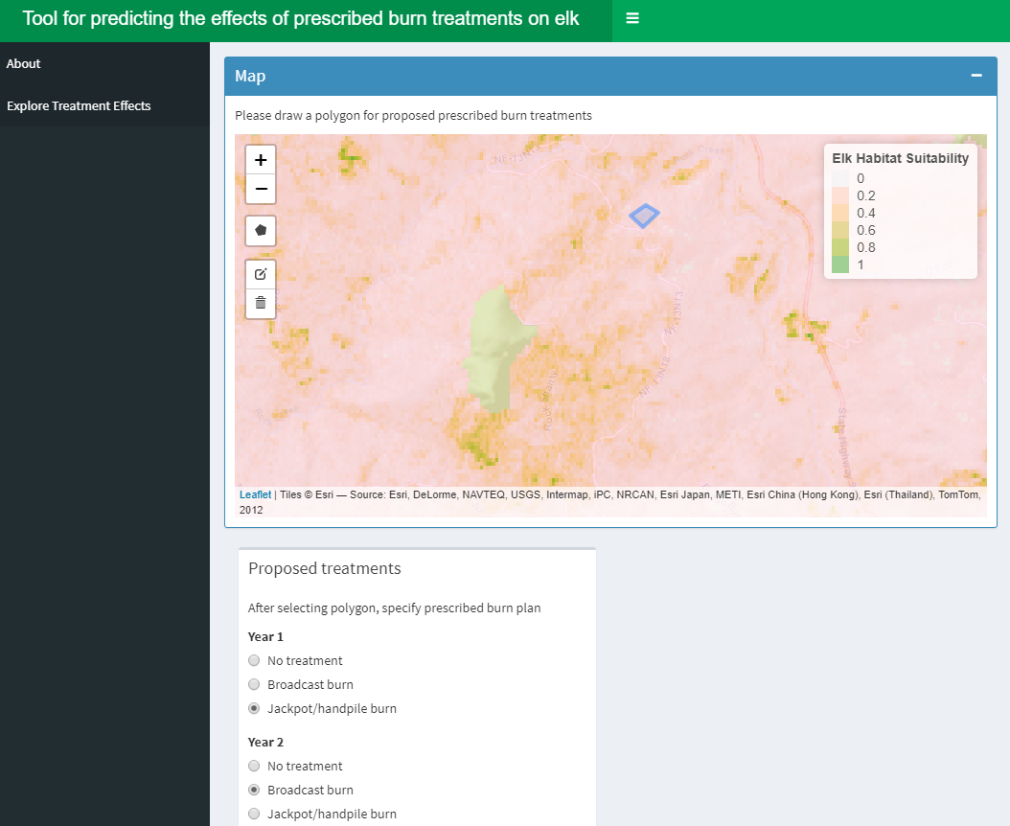
Presentation overview
Part 1:
Work with Karuk Tribe on elk habitat in Northern California
R Shiny app as a fire and wildlife management decision support tool
Part 2:
Hands-on coding workshop building out a leaflet-based R Shiny app

Slide 3
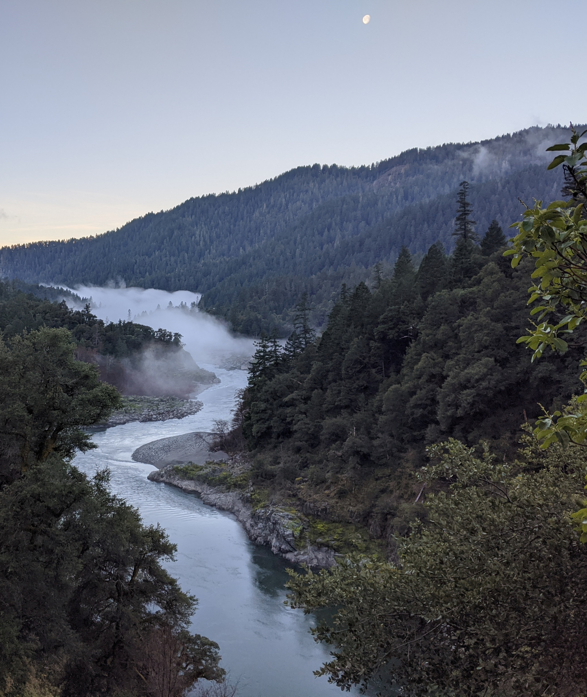
Elk in the Klamath
Extirpated in the 1800s, last elk in Siskiyou county lost in 1870s
Hunted extensively by settlers during the gold rush, and killed for crop depredation (Toweil and Thomas 2002)
Traditional indigenous fire management practices that produced favorable habitat conditions were also severely limited and eventually stopped in the mid 1800s (Higgins 1986)

Slide 4
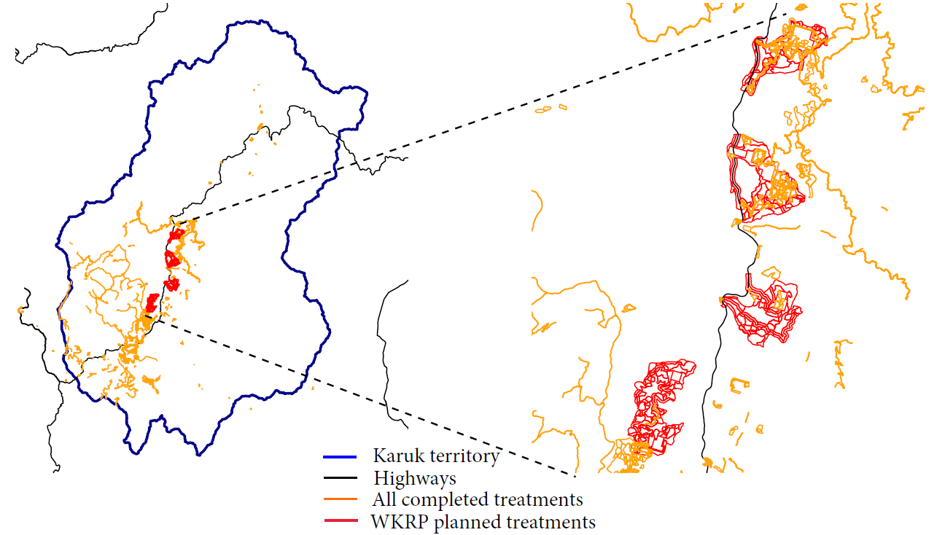
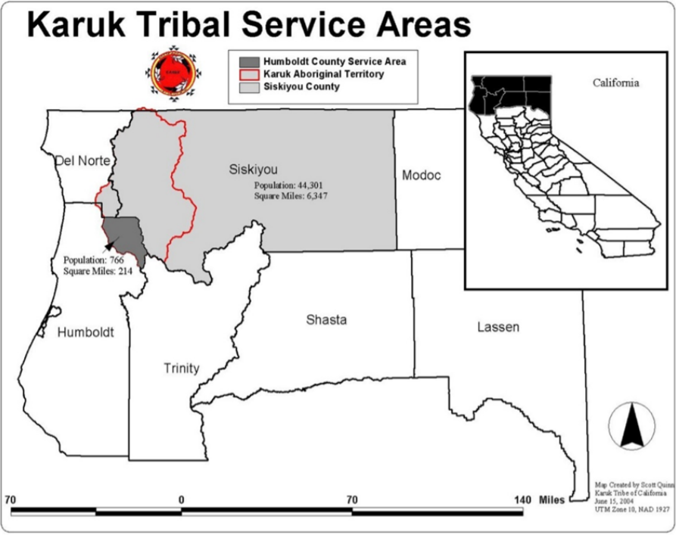

Slide 5
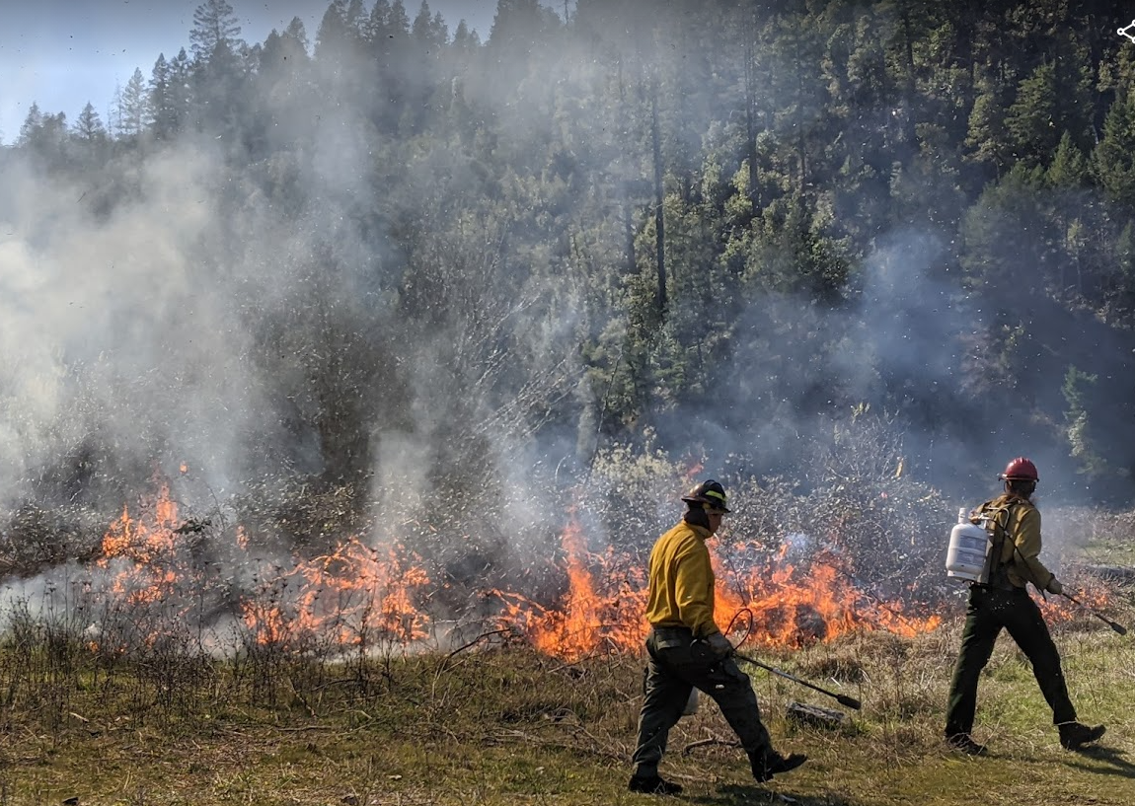
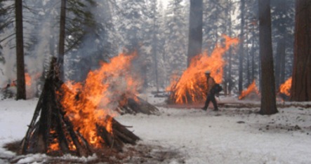
What are the effects of burn treatments on elk habitat?
Fit species distribution model (SDM, maxent) to elk scat collected in 2018
Habitat variables consisting of vegetation cover data
Predicted elk habitat suitability in 2013 and 2018 using SDM and measured change
Fit spatial autoregressive model predicting change in elk habitat based on burn treatments in each year and control variables (elevation, terrain ruggedness, aspect)
Broadcast burn
Handpile burn

Slide 6
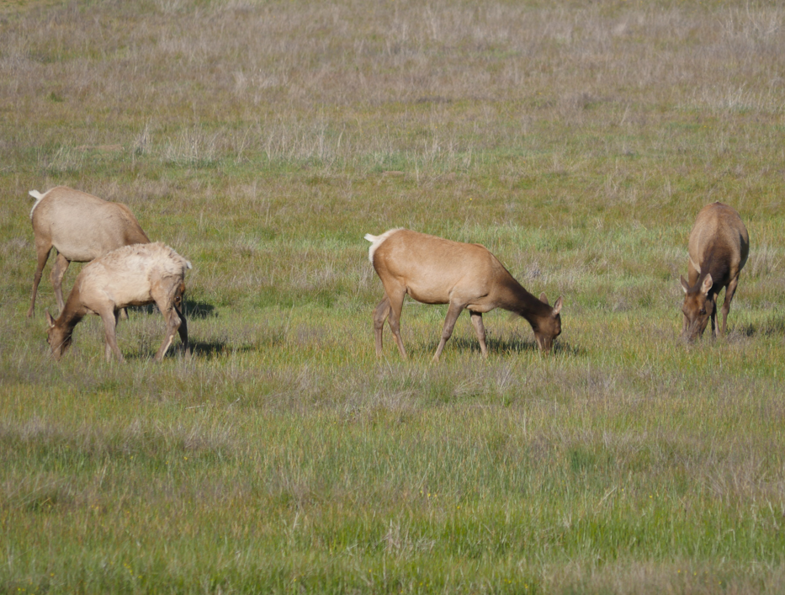
Prescribed burns based on Karuk TEK maximize elk habitat increases
Generally, broadcast burns were best for increasing elk habitat, with repeated broadcast burns even better
Just treating a site with jackpot/handpile burns had a negative effect
However, mixed jackpot/handpile burn with multiyear broadcast burns had the highest positive effect on elk habitat

Slide 7
How might we apply these results?
Given our study’s timeframe of five years, we can predict the effects of a multiyear prescribed burn treatment plan on elk habitat five years from now
It is time intensive to learn the R environment, code different treatment plans, and predict their effects (even for the study authors!)
A shiny app allows users to examine the predicted effects of prescribed burn treatment plans in a rapid and easy-to-comprehend way

Slide 8
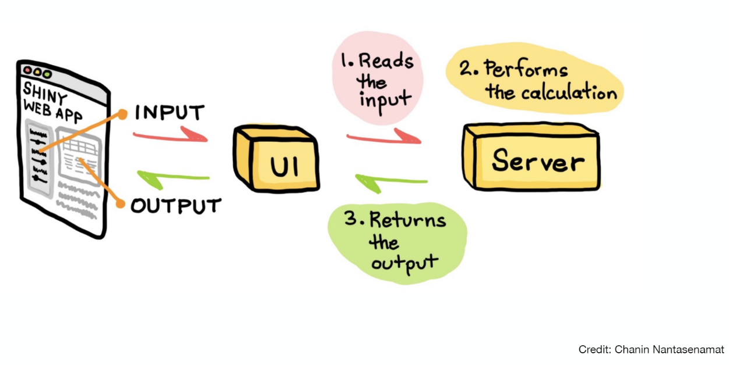
R Shiny App overview

Slide 9
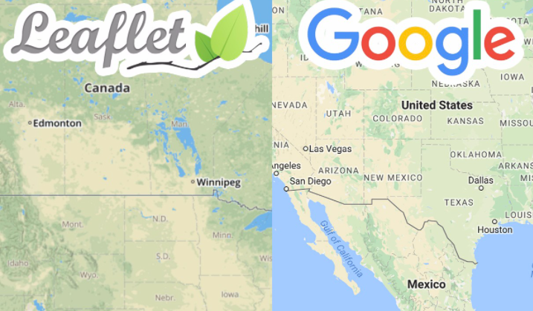

Leaflet
Open source javascript mapping software
NYT, Washington Post, mapbox use leaflet
Great functionality within R and R shiny
A great resource: https://rstudio.github.io/leaflet/

Slide 10

Shiny app work through
Same study system
Simpler data and code
Starting with ‘base’ leaflet map and adding data/interactivity
Here we go!

